Slide 1

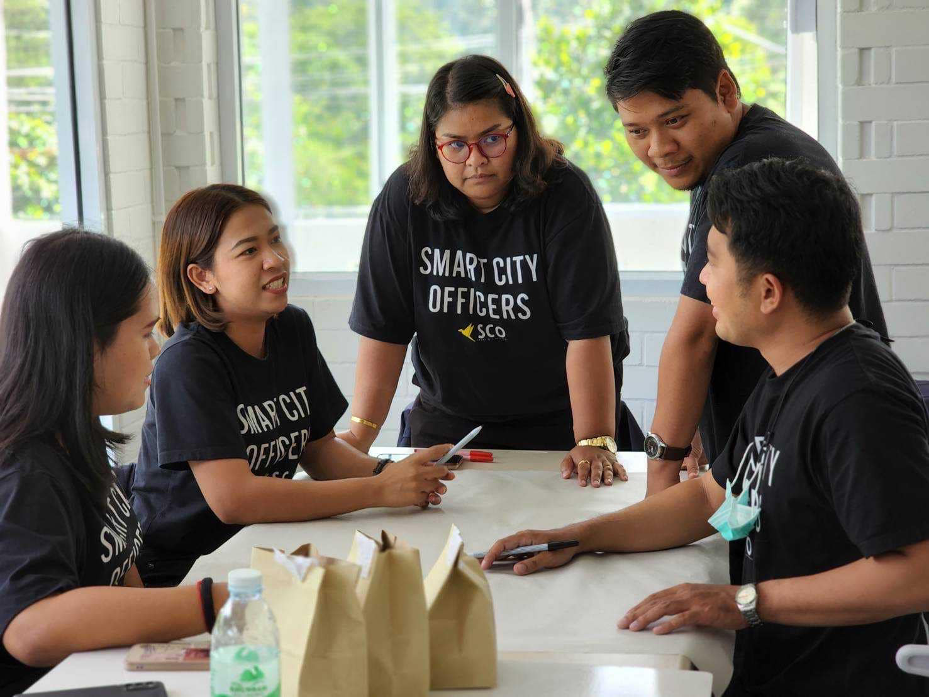


ASEAN Digital Capacity Building for Smart Cities

Slide 2
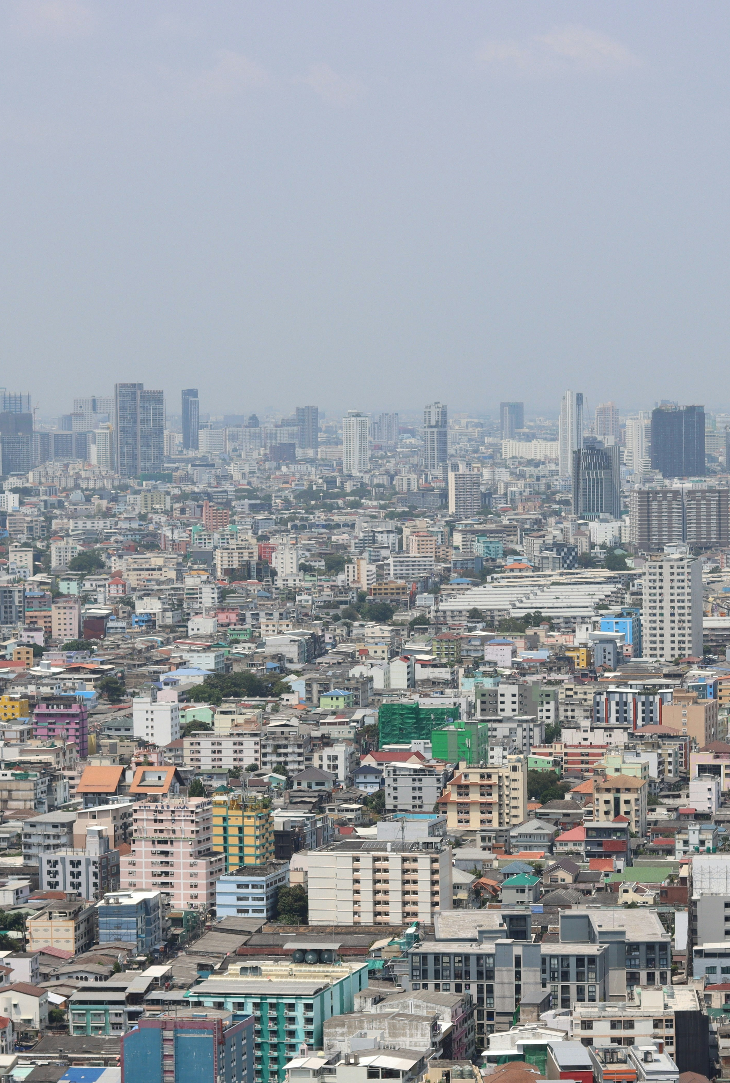
ASEAN Digital Capacity Building for Smart Cities
This comprehensive initiative aims to enhance digital capabilities across ASEAN member states through a structured approach to smart city development. The program will run throughout 2025, bringing together policymakers, urban planners, and technologists to address specific urban challenges through collaborative learning and practical implementation.
The project combines online engagements, experimental workshops, and resource development to create sustainable smart city frameworks tailored to the ASEAN context. With Nakhon Si Thammarat as a model city, participants will gain hands-on experience with successful smart city initiatives that can be adapted to their local environments.
Photo by Anon P on Unsplash

Slide 3
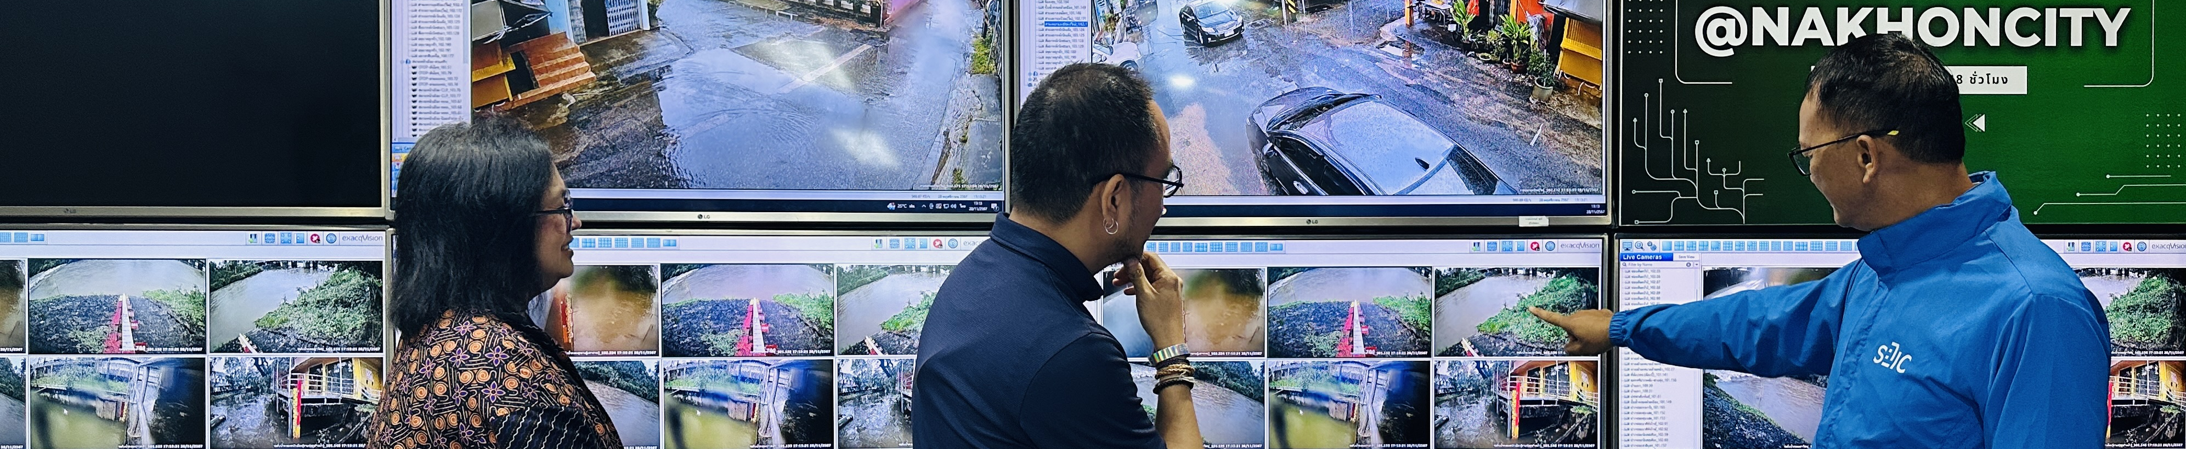
All photos belong to Nakhon Si Thammarat City Municipality and are copyrighted, except when used in good faith for non-commercial purposes.
Project Management Framework
Formation of Project Team
February 2025: Establishing a team with project manager, technical experts, and administrative staff
Bi-Weekly Coordination
Virtual meetings with ADSOM, ASCN, and MPAC representatives to track progress and resolve issues
Quarterly Reviews
Comprehensive assessment meetings in April, July, October, and December with member state representatives
Monthly Reporting
Progress reports submitted to ADGSOM within 5 days of month-end
The management structure ensures transparent project execution with approximately 15-20 stakeholders participating in each review meeting. This framework facilitates alignment among all parties and enables timely issue resolution throughout the project lifecycle.

Slide 4
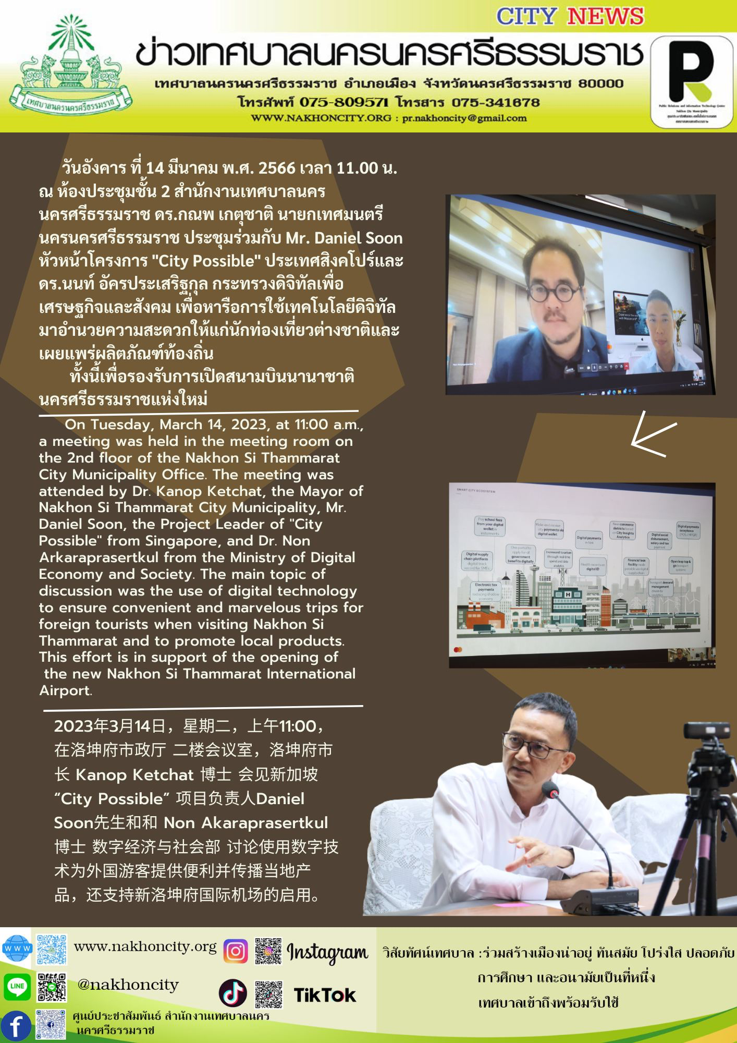
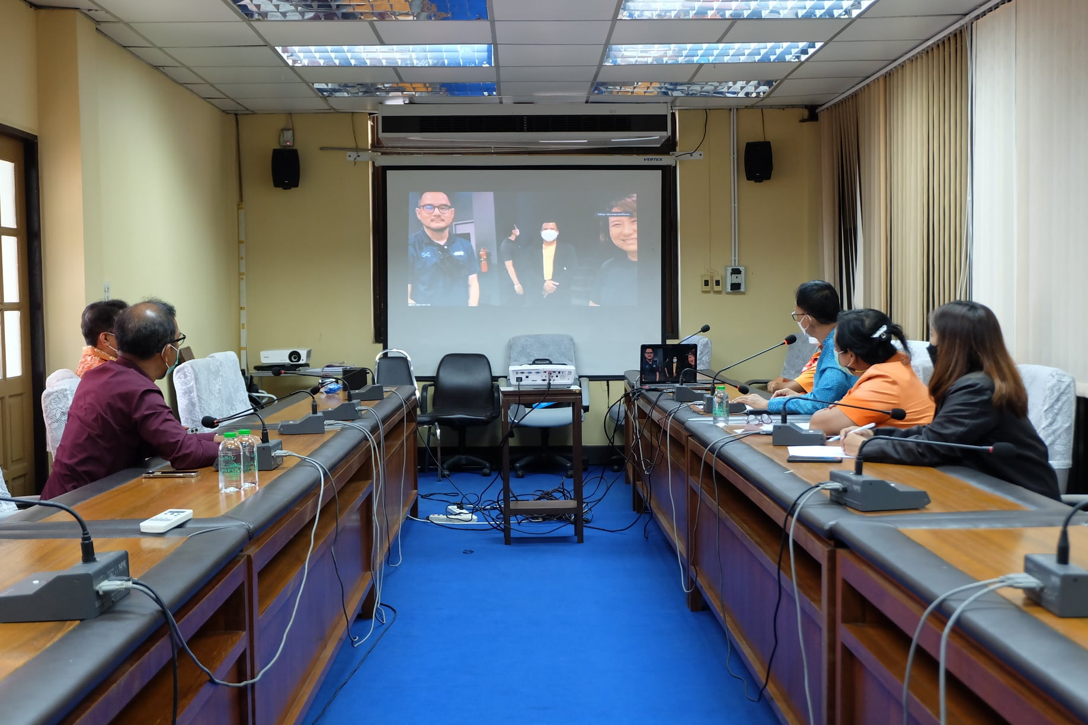




Online Preparatory Engagements
Webinar Series (Mar-May 2025)
Three 2-hour virtual sessions covering smart city frameworks, technology integration, and needs assessment results
Needs Assessment
Online surveys to identify priority areas such as e-services and flood management
City Challenge Briefs
Participants submit 1-page briefs on their city's specific smart city challenges
Workshop Design
Integration of feedback into tailored workshop content
These preparatory engagements will involve 30-35 policymakers, urban planners, and technologists from across ASEAN member states. Selection criteria ensure diverse representation from both urban and rural areas, including ASCN and non-ASCN cities, with participants committed to attending follow-up workshops.
All photos belong to Nakhon Si Thammarat City Municipality and are copyrighted, except when used in good faith for non-commercial purposes.

Slide 5
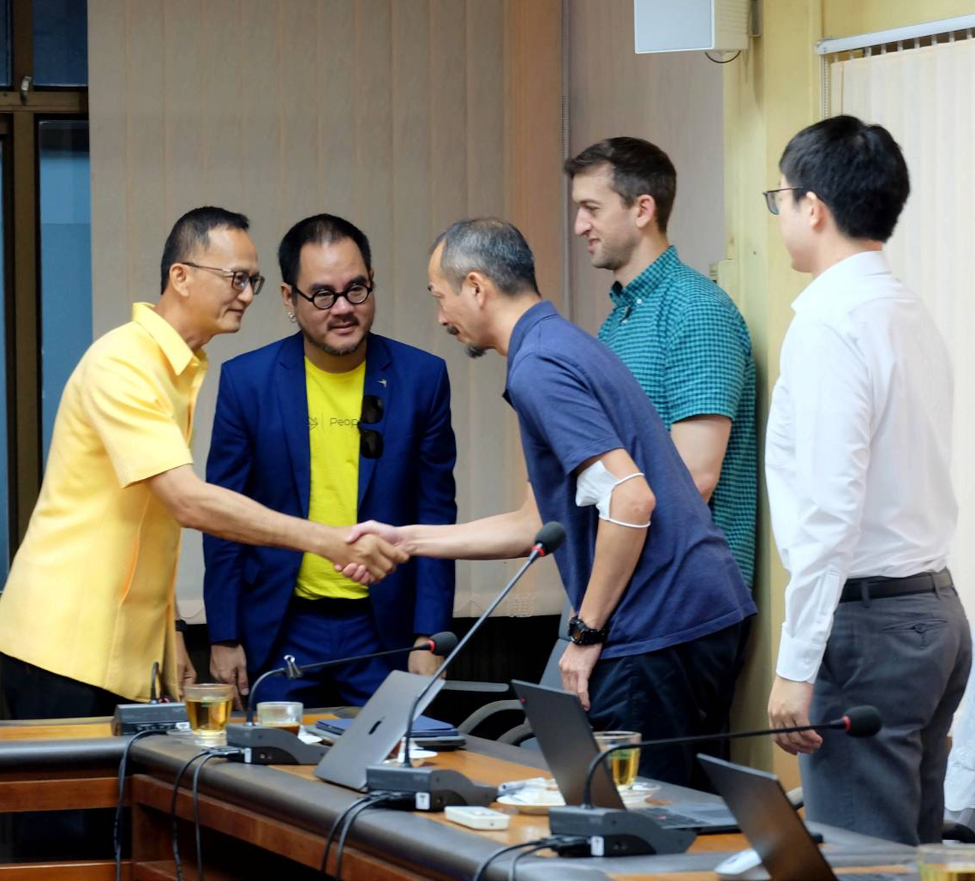
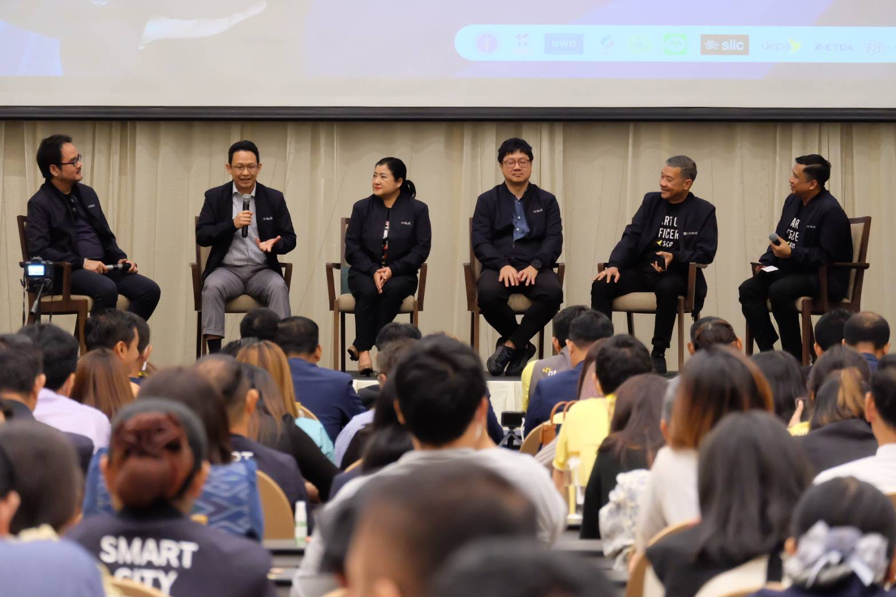
Participant Selection
and Engagement
Selection Criteria
External Participants
Active role in smart city planning or implementation
Private sector experts from Thailand Digital Catalog
Representation from diverse ASEAN cities (urban/rural, ASCN/non-ASCN)
ASEAN Smart Cities Network mentors
Local officials from Nakhon Si Thammarat
Commitment to attend all program components
Participation Requirements
All photos belong to Nakhon Si Thammarat City Municipality and are copyrighted, except when used in good faith for non-commercial purposes.
Submission of city challenge briefs
Completion of needs assessment surveys
Active contribution to group exercises
The program will maintain consistent participation across all activities, with the same core group of 30-35 policymakers and planners attending both the webinar series and the on-site workshop. This approach ensures continuity of learning and enables the development of lasting professional relationships among participants.

Slide 6
Experimental Workshop
in Nakhon Si Thammarat
Day 3: Group Exercises
Day 2: Field Visits
Facilitated sessions to draft city-specific smart city plans with guidance from technical experts
Day 1: Presentations
On-site exploration of implemented smart city projects including flood monitoring systems and digital service kiosks
Detailed sessions on Nakhon Si Thammarat's smart city model, focusing on citizen e-services and flood prevention systems
This 3-day workshop in July 2025 will provide hands-on exposure to successful smart city initiatives. Participants will receive a pre-workshop handbook draft and case study summaries two weeks prior to the event.
The workshop logistics include venue, meals, and materials funded by Thailand (USD 5,000), with travel and per diem for selected participants funded by AICTF (USD 11,700).

Slide 7








Online Collaboration Platform
Platform Launch
Moderated Discussions
August 2025: Cloud-based platform deployment for continued knowledge sharing
Monthly discussion prompts on topics like scaling e-services
Usage Analytics
Network Expansion
Quarterly reporting on platform engagement and impact
Invitations extended to ASCN cities and Thailand Digital Catalog firms
The digital forum will be managed by depa's technical team and will serve as a hub for participants to share updates, challenges, and solutions. This platform ensures continuous knowledge exchange beyond the formal program activities and creates a sustainable community of practice among ASEAN smart city practitioners.

Slide 8
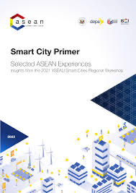
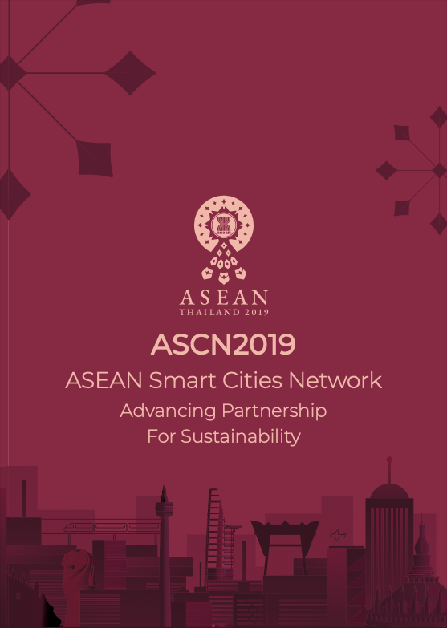





Smart City Handbook Development
Initial Content Development
March-May 2025: Compiling best practices and frameworks
Expert Review Process
June 2025: Draft review by ASCN experts
Previous world-class publications published by depa
Finalization and Distribution
September 2025: Digital distribution to all ASEAN member states
The handbook will serve as a comprehensive resource for smart city development across ASEAN. Content will include detailed case studies from Nakhon Si Thammarat, frameworks for citizen-centric design, and innovative financing models for smart city initiatives. Feedback on the handbook will be collected through surveys in November 2025 to assess its utility and impact.

Slide 9
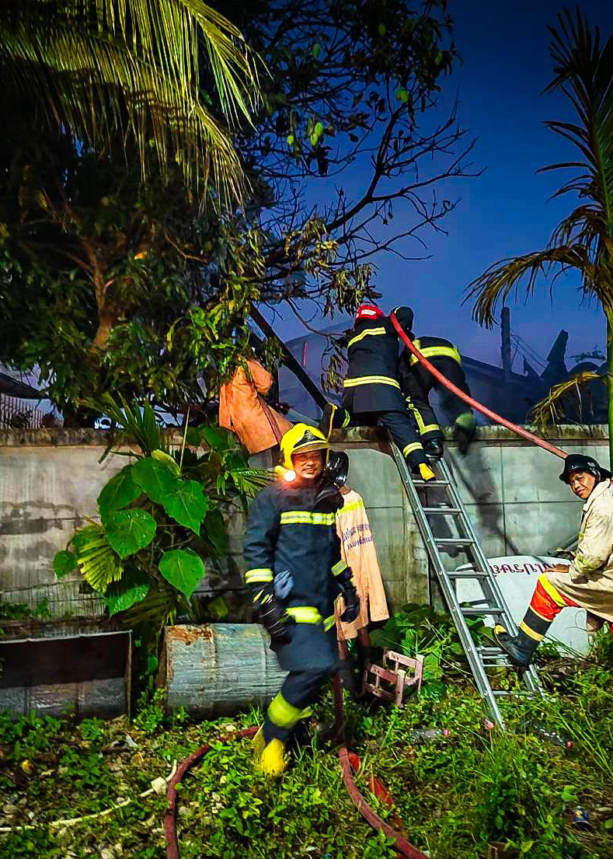
Project Timeline and Milestones
January-February 2025
Pre-planning, team formation, and initial coordination meetings
March-May 2025
Webinar series, needs assessment, and handbook drafting
June-July 2025
Handbook review and 3-day workshop in Nakhon Si Thammarat
August-September 2025
Digital forum launch and handbook finalization
October-December 2025
Final reviews, feedback collection, and project completion
The project follows a structured timeline with clear milestones throughout 2025. Each phase builds upon previous activities, creating a cohesive capacity-building journey. The final evaluation in December will assess overall impact and document lessons learned for future ASEAN smart city initiatives. A comprehensive completion report will be submitted to the ASEAN Secretariat, marking the formal conclusion of the project.
All photos belong to Nakhon Si Thammarat City Municipality and are copyrighted, except when used in good faith for non-commercial purposes.

Slide 10
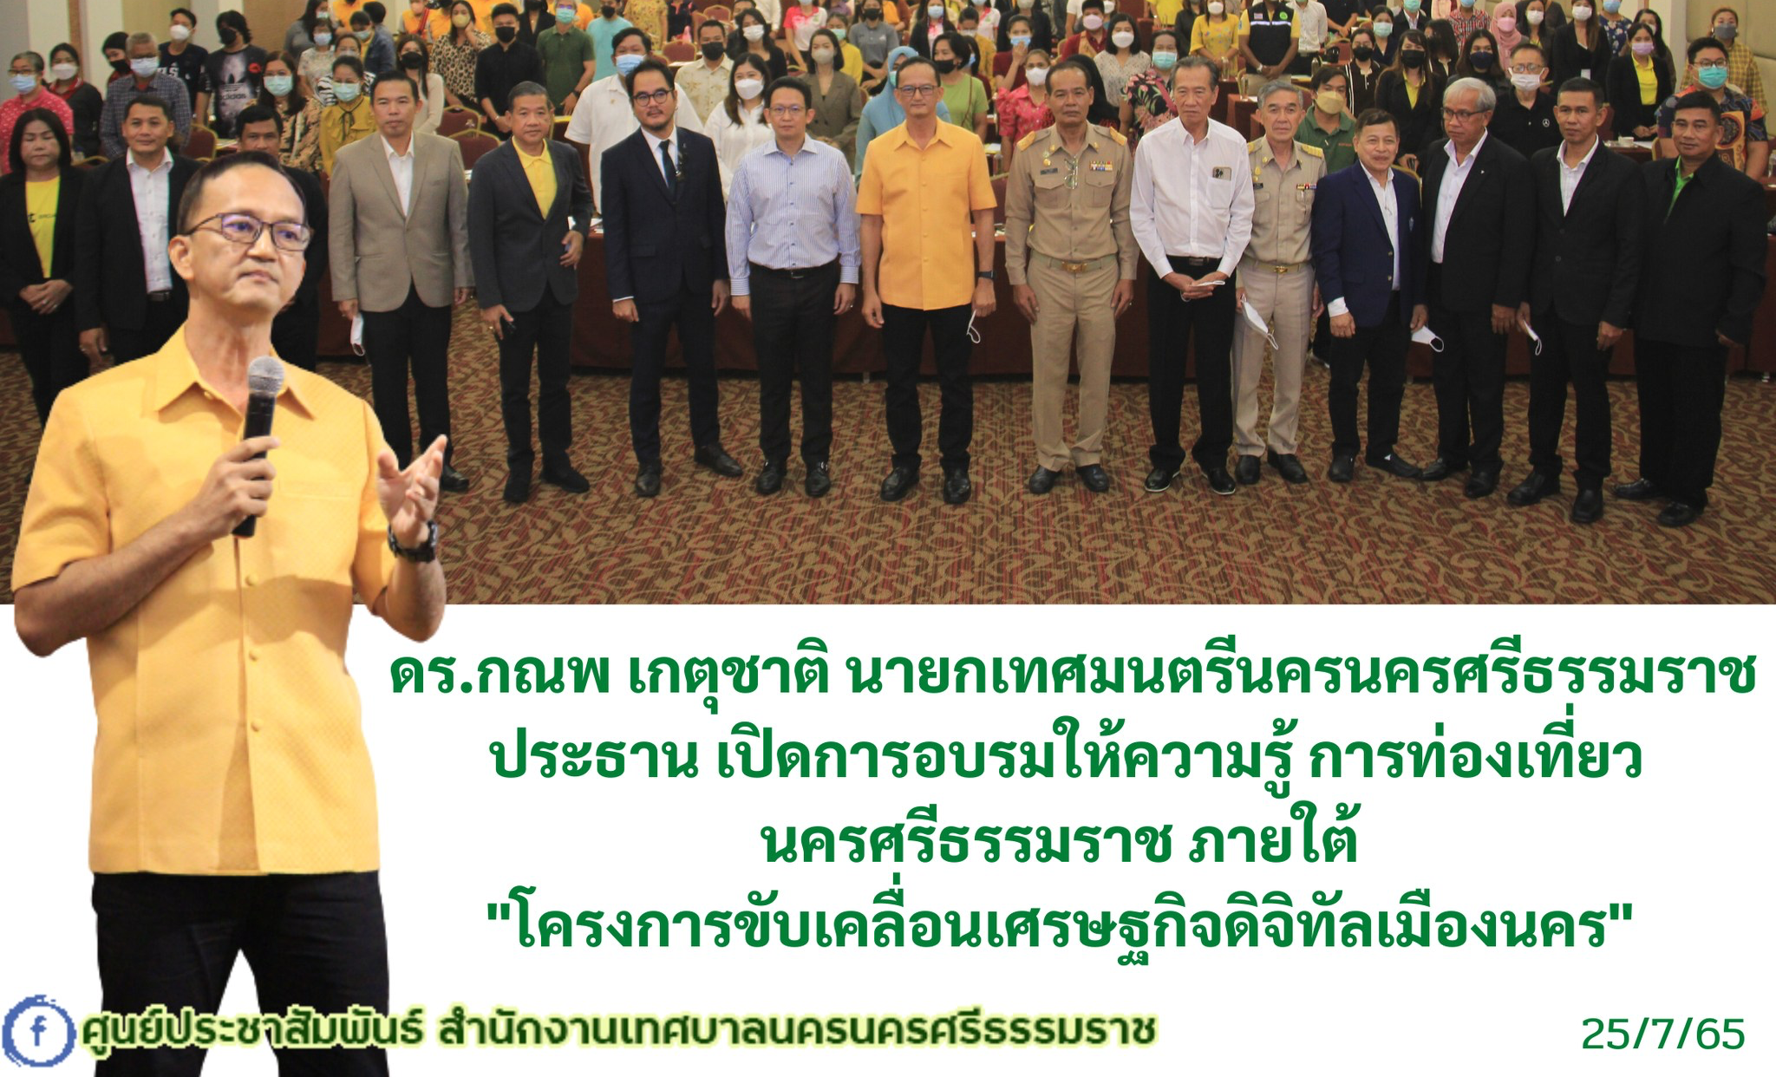
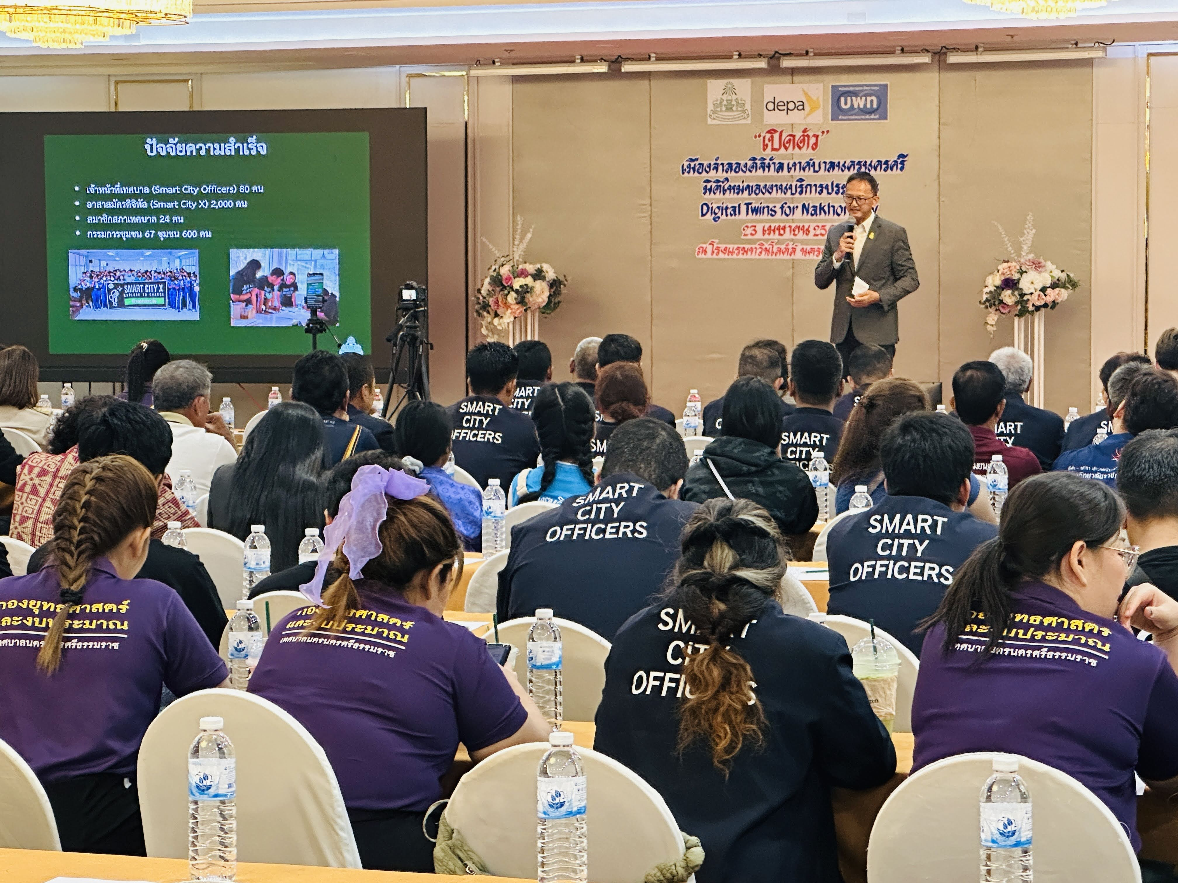
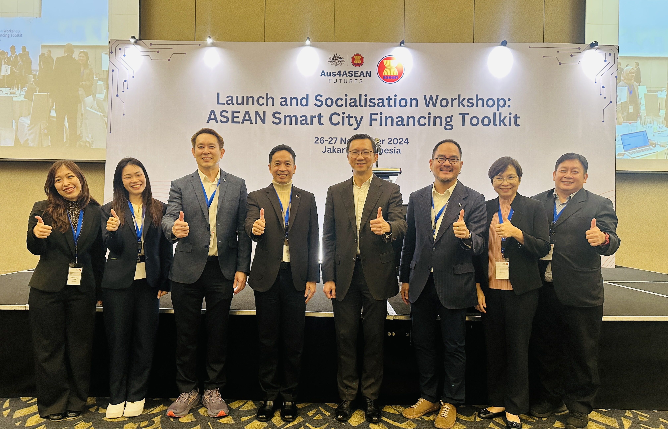
Project Management Framework
Depa: The Departments of Smart City Promotion and Intelligence and Digital Strategies will lead the project.
Nakhon Si Thammarat City Municipality: The City Municipality will help with local support and insights.
ASEAN Secretariat: The ASEAN Connectivity Division will provide regional coordination and expertise.
Depa’s Track Record on International Training:
Smart City Officers Program (SCO): Various Batches with more than 2,000 mayors and key deicision-makers trained;
Chief Smart City Officers Program (CSCO): First of its kind in Southeast Asia under the mandate of ASEAN in 2018 with 3 batches of mayors and key decision-makers trained;
Smart City Leadership (SCL) Program: For high-level public and private sector executives wi`th 4 batches and more than 300 C-level excecutives trained;
Awarded Best Partnership Award: at World Smart City Expo in Korea in 2023 for its robust capacity building program;
Awarded Best Project Award at Smart City World Congress in China in 2024: for the 3C concept incorporating Capacity Building, with Co-Creation and Collaboration.
Awarded ASOCIO Best Project Award in 2024: Robust capacity building programs for everyone.
All photos belong to Nakhon Si Thammarat City Municipality and are copyrighted, except when used in good faith for non-commercial purposes.

